Slide 1
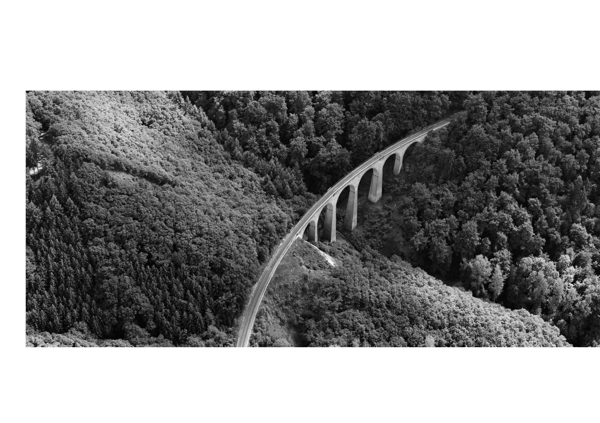
Vontobel Specials Swiss Equities

Slide 2
Table of contents
Summary
Swiss equities
Our investment approach
Vontobel Specials Swiss Equities
Appendix

Slide 3

Our mode of operation – your benefits
“We invest assets in the Swiss equity markets with a balance-sheet-oriented, commercial view on the enterprises, a focus on stability and under consideration of Swiss values.”
High export share of the companies led to a global diversification
Mandate is based on direct investments in Swiss equities
Outstanding yield on the basis of first-class research; Vontobel is the number 1 in the field of research for Swiss equities
1 Vontobel named as the number 1 in research/brokerage for Swiss equities in the Thomson Extel Surveys from 2011, 2012, 2013, 2014, 2015, 2016, 2017 and 2018

Slide 4
Swiss equities are attractive – Vontobel offers you the needed competence
Why Swiss equities?
Why Vontobel for Swiss equities?
The Swiss equity market is marked by strong corporate governance, diversity, intelligence, quality, reliability and simplicity
Swiss companies are globally diversified
In an international comparison, the Swiss equity market has demonstrated outstanding performance over the past 30 years
Vontobel is an independent, family-owned Swiss private bank that has been standing for stability, financial strength and risk awareness for generations
Our proven research competencies¹ and long-standing experience
In total, we manage about CHF 35 billion in multi-asset investments with dedicated experts
Our solution: Vontobel Specials
Our track record* (Jan 2012 – Feb 2019)
Direct investment in sound Swiss companies with a long-term focus
Structured investment process based on quantitative and qualitative criteria
Active selection of securities to outperform the overall market
Systematic monitoring of the company results and business operations
¹ Vontobel named as the number 1 in research/brokerage for Swiss equities in the Thomson Extel Surveys from 2011, 2012, 2013, 2014, 2015, 2016, 2017 and 2018. * Performance figures are gross of fees and costs and based on individual client portfolios. Actual performance may deviate from this significantly. Past performance is no guarantee of future results and in no way constitutes an assurance on the part of Bank Vontobel AG with regard to returns or risks in the future. Performance and risk indicators are calculated gross, i.e. without fees, expenses and taxes etc. The amount of the commissions, fees and other payments to be deducted is based on our currently applicable pricing and services schedule. **Swiss Equities Benchmark consists of 95% Swiss Performance Index (SPI®) and 5% JP. Morgan Cash 1 Month CHF (Until June 30, 2018: Citigroup Eurodeposit 1 Month CHF).

Slide 5
Table of contents
Summary
Swiss equities
Our investment approach
Vontobel Specials Swiss Equities
Appendix

Slide 6
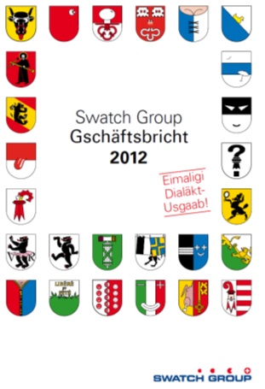
Swiss equities: Identification with Switzerland and its values
S’Geleitwort vo dr Presidäntin
De Gschäftsbricht in Schwiizerdüütsch! Mer wänd eusi schtarch Identifikation mit eusem Land und sine Wärt no meh underschtriche. Dezue ghöre Verlässlechkeit, die höchi Qualität i de Uusfüehrig, Intelligänz, aber hauptsächlech Villfalt, Eifachheit und Bescheideheit. I dem Senn und Geischt hämmer weder mol öppis positiv Provokativs gmacht: Mer händ die düütsch Version vo eusem Gschäftsbricht vo A bes Z mitere schwiizerdüütsche Version ersetzt! Das isch wahri Swissness, womit mer eusi Landslüüt es bezli uufrüttle, wo mängisch zor ehner konventionelle Site neige, wo vor allem of ehri Secherheit bedacht send und schön vorsichtig und bequem dor s’Läbe wänd goh.
Swatch annual report 2012: “Eimaligi Dialäkt Usgaab”

Slide 7












Swiss equities: The way to success with Swiss values
Corporate Governance
In an international comparison, Swiss companies have a well-established culture of strong corporate governance
Diversity
Swiss companies have a strong international focus. We thus invest with a global footprint
Intelligence
The competition situation with a strong franc, the education center and a flexible job market form the basis for innovation
Quality
High profit margins, stable cash flows and a sound balance sheet are the fundamental data we are looking for
Reliability
Many enterprises are backed by a strong family, which enables a long-term, sustainable strategy
Simplicity
We invest in enterprises with a tangible, comprehensible and successful business model

Slide 8




Corporate Governance: Swiss companies have a strong corporate governance
Corporate governance rating (in points)
Swiss companies value the principles of strong corporate governance
Important evaluation criteria include shareholder base and capital structure, shareholder participation rights, composition of board of directors and executive management; information policy, and compensation and participation models
We consider strong corporate governance as a central component of a stock’s long-term structural growth
Very good
Maximum*: 86
Switzerland: 82
Minimum: 3*
Poor
Source: Sustainalytics / FuW; zRating; March 2017
Maximum Denmark, Minimum Somalia

Slide 9
Diversity: Swiss companies are globally diversified
Sales share by region for SMI®* companies
The home market sales of all SMI® companies amount to 8%. For all SPI® companies, they amount to 11%
Apart from Norway and Sweden, Switzerland is one of Europe’s most global stock markets
In other regions, the global footprint is significantly smaller
Europe (ex Switzerland and UK)
North America
Japan
Europe: 28%
Global: 72%
North America: 71%
Global: 29%
Japan: 72%
Global: 28%
Source: Morgan Stanley / Graph: FuW, ck
SMI®: Swiss Market Index, SPI®: Swiss Performance Index. The Swiss Market Index contains the 20 largest Swiss companies. The SPI® contains more than 200 companies as of 28.02.2019
*Global split: North America: 30%, Western Europe: 25%, Asia/Pacific region: 20%, Latin America: 9%, Eastern Europe: 4%, Middle East, Africa: 4%

Slide 10
Intelligence: The strong franc forces companies to be innovative
Depreciation of currencies versus CHF since 1973
On 15 September 1971, President Nixon cancelled the convertibility of the US dollar to gold
Since March 1973, most of the world’s currencies have no longer been pegged to the US dollar, and flexible exchange rates have been used
Since then, the Swiss franc has become the world’s strongest currency
The strength of the Swiss franc continues to be a burden for enterprises, forcing them to continuously improve their productivity and innovation in order to remain competitive at the international level
The high export share despite the strong currency shows that this has been achieved
Change from 01.01.1973 – 28.02.2019
* DEM (German mark) until 31.12.1998, EUR from 01.01.1999

Slide 11


Quality: High-quality industries, premium names
Industry weighting
No. of companies in the industry
Capitalization (CHF 1.3 trillion)
SPI®: Swiss Performance Index. The SPI® contains more than 200 companies
as of 28.02.2019

Slide 12
Reliability: Compelling long-term performance over 30 years
SPI® compared to international indices denominated in Swiss francs
SPI®: Swiss Performance Index. The SPI® contains more than 200 companies
Actual performance may deviate from this significantly. Past performance is no guarantee of future results and in no way constitutes an assurance on the part of Bank Vontobel AG with regard to returns or risks in the future. Reference currency CHF, as of 28.02.2019.
Source: Bloomberg

Slide 13
Table of contents
Summary
Swiss equities
Our investment approach
Vontobel Specials Swiss Equities
Appendix

Slide 14
Nervous capital markets vs stable real economy offers opportunities
Equity price (capital market)
Earnings per share (real economy)
The actual earnings per share dropped only 20 percent
During the financial crisis, the share price dropped almost 50 percent
Source: Bloomberg
as of 28.02.2019

Slide 15

Commercial risk view, not mere financial theory
Nestlé and the franc shock
How we act
Franc shock (15 January 2015: The Swiss franc increases 15 to 20 percent over other currencies)
In financial theory, the risk goes up when the price drops
A financial theorist would regard the price drop of Nestlé as a risk increase and would sell the equity as a “risk management measure”
Our risk understanding is business-oriented; thus, we also regard the price decline as a more attractive valuation
A good enterprise analysis reveals the international orientation of Nestlé and the unchanged profit situation despite the franc shock; so we buy the equity in order to “make use of opportunities”
The market adapts to the reality (Nestlé operates around the globe and only depends on the Swiss franc to a limited degree)
The market makes Nestlé drop 13% percent (Products of Nestlé and all other Swiss companies are becoming too expensive)

Slide 16
Which companies do we want regarding business model?
A sound, global business model that...
has proved successful in practice
has high and/or rising profit margins
continues to have a predictable and, most importantly, not unidirectional success outlook
creates added value for the shareholder and focuses on a sound balance sheet
delivers products and services that are able to compete, not only in Switzerland, but also internationally
We buy companies like Komax or Interroll, which…
focus on their core competencies
pursue a simple and transparent strategy
produce tried and tested high-quality products
have a strong balance sheet and effectively distribute dividends
We do not buy companies like Evolva or Newron Pharmaceuticals, which...
depend greatly on individual products
still need to overcome major regulatory obstacles
do not have any profit history
burn a lot of money

Slide 17
Which companies do we want regarding management?
Robust management that ...
is connected to the owners or that operates with a entrepreneurial perspective with a view to cost-conscious capital allocation
remains down to earth
communicates openly and honestly
plans on a long-term basis and is geared to the company
We buy companies like Geberit or Forbo, which...
communicate transparently and openly
have a long-standing, tried and tested management
perform proactive succession planning
create added value for the shareholder through entrepreneurial governance
We do not buy companies like Aryzta or Credit Suisse, which...
apply an obscure compensation policy
absorb high management capacities due to company-specific problems
destroy shareholder value through incomprehensible decisions

Slide 18
Vontobel Specials Swiss Equities Structured three-stage investment process
Investment universe
Bottom-up analysis
Portfolio construction
Number of securities: ~210
~30
The investment universe comprises the approximately 210 companies in the SPI® index
Our Vontobel equity research covers about 120 Swiss companies
Companies with a market cap of less than CHF 500 million are excluded from the investment universe, leaving about 100 securities
The liquidity (traded volume) is another filter; this filter reduces the universe to approximately 80 securities

Slide 19
Vontobel Specials Swiss Equities Structured three-stage investment process
Investment universe
Bottom-up analysis
Portfolio construction
Number of securities: ~210
~30
Quantitative factors:
Balance sheet Sales, profit, debt, equity ratio
Valuation P/E, EV/EBITDA, book value, dividend yield
Profitability Cash flow, ROIC, ROE, ROA
Qualitative factors:
Company Management, strategy, corporate governance
Environment Competitors, market share, dependence
Perspectives Outlook, reporting, margin development

Slide 20
Vontobel Specials Swiss Equities Structured three-stage investment process
Investment universe
Bottom-up analysis
Portfolio construction
Number of securities: ~210
~30
Time
Active decision to execute the transactions
Position size
Portfolio position regardless of the benchmark weightings (at least 2 percent)
Structuring
Concentrated portfolio with clear positioning

Slide 21
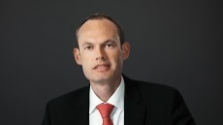


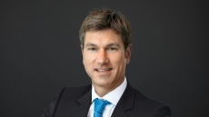

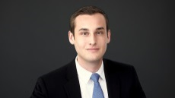



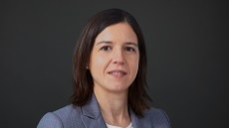
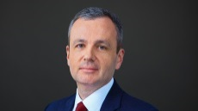



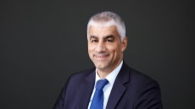
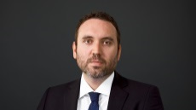


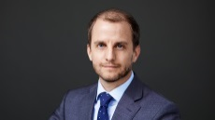
Our experienced team: Comprehensive competences and broad experience
Portfolio management
Swiss Equity Research-Team
Responsibility:
Overall performance
Investment decision
Asset allocation
Security selection
Monitoring
Roland Bart
Experience: 26 years
P. Spiliopoulos
Head of Research,
Electr., Industr., Telecom
Dr. C. Bänziger Medical Technology
J.-P. Bertschy
Food, Services
Michael Foeth
Serv., Logistics, Tech.
P. Furger
Mec. Engineering
Responsibility:
Substitute for Roland Bart
Total Performance
Security selection
Monitoring
Damla Üsküp
Experience: 7 years
L. Zini Consumer
M. Lichvar Industrials
Dr. M. Maldonado
Pharma&Biotechn.
B. Pomrehn Build. Suppl., Packag.
Dr. S. Schneider
Pharma&Biotechn.
Responsibility:
Implementation
Corporate Action monitoring
Cash Flow management
Beat Schnider
Experience: 12 years
S. Schürmann Insurance& Real Estate
A. Venditti
Banks
R. Weber
Luxury, Retail
Global Macroeconomic Research
Responsibility:
Substitute for Beat Schnider
Massimiliano Balleriano
Experience: 9 years
Dr. R. Wiedemann
Head Economic Research
Dr. R. Cueni
Senior Economist

Slide 22

Vontobel Equity Brokerage Leading Broker for Swiss equities for over 10 years
2018 | 2017 | 2016 | 2015 | 2014 | 2013 | 2012 | 2011 | 2010 | 2009 | 2008
Vontobel | Vontobel | Vontobel | Vontobel | Vontobel | Vontobel | Vontobel | Vontobel | Helvea | UBS | Vontobel
MainFirst | MainFirst | Baader/Hel. | Baader/Hel. | UBS | UBS | UBS | Helvea | Vontobel | Vontobel | Kepler
Kepl. Cheuv. | Baader/Hel. | Kepl. Cheuv. | MainFirst | Kepl. Cheuv. | Helvea | Helvea | UBS | UBS | Helvea | Helvea
UBS | Kepl. Cheuv. | UBS | UBS | MainFirst | Kepl. Cheuv. | Kepler | Kepler | Kepler | Berenberg | Cheuvreux
Baader/Hel. | UBS | MainFirst | Kepl. Cheuv. | Baader/Hel. | MainFirst | MainFirst | MainFirst | NZB | Kepler | NZB
19,000 investor participants
1.1 million individual investor votes
74 countries
2018 | 2017 | COMPANY NAME | POINTS | IN %
1 | 1 | Vontobel | 10’769 | 22.2
2 | 2 | MainFirst Bank | 8’189 | 16.9
3 | 4 | Kepler Cheuvreux | 6’416 | 13.2
4 | 5 | UBS | 6’355 | 13.1
5 | 2 | Baader / Helvea | 5’741 | 11.8
6 | 6 | Credit Suisse | 3’567 | 7.4
7 | 8 | Zürcher Kantonalbank | 2’515 | 5.2
8 | 10 | Exane BNP Paribas | 982 | 2.0
9 | 11 | Mirabaud Securities | 596 | 1.2
10 | 9 | Berenberg | 523 | 1.1
11 | 12 | Goldman Sachs | 365 | 0.8
12 | n/a | Morgan Stanley | 356 | 0.7
13 | n/a | Oddo BHF / Natixis | 350 | 0.7
14 | 14 | Bank of America Merrill Lynch | 332 | 0.7
15 | n/a | Citi | 321 | 0.7
Vontobel again ranked #1 brokerage firm for Swiss equities by Extel Survey in 2018
Vontobel is well ahead of its closest peers
Source: Extel Survey

Slide 23
Table of contents
Summary
Swiss equities
Our investment approach
Vontobel Specials Swiss Equities
Appendix

Slide 24
Product information
Product
Discretionary, focused mandate solution, which invests in Swiss equities. Stock selection is based on an active investment approach
Investment strategy
Single asset class strategy, Swiss equities (growth)
Investment strategy
Investment strategy
CHF
Investment instructions
Investment instructions
Investment instructions are possible for amounts starting at CHF 3,000,000
Investment universe
Investment universe
Direct investments in shares. Investment funds/ETFs, structured products and derivatives are only used in exceptional cases
Benchmark
Benchmark
Swiss Performance Index (SPI)
Fee model
Fee model
All-in fee model
“Small”
“Large”
Minimum investment
CHF 250,000 or equivalent in foreign currency
CHF 500,000 or equivalent in foreign currency
Structure
10-15 individual shares, combined with investment funds/ ETFs
25-30 individual shares

Slide 25
Achieved added value
Performance (01.01.2012 – 28.02.2019, gross)
Outperformance
Performance figures are gross of fees and costs and based on individual client portfolios. Swiss Equities Benchmark consists of 95% Swiss Performance Index (SPI®) and 5% JP. Morgan Cash 1 Month CHF (Until June 30, 2018: Citigroup Eurodeposit 1 Month CHF). Actual performance may deviate from this significantly. Past or simulated performance is no guarantee of future results and in no way constitutes an assurance on the part of Bank Vontobel AG with regard to returns or risks in the future. Reference currency CHF, as at February 2019.

Slide 26
Performance and risk measures
Performance and risk measures (01.01.2012 – 28.02.2019, gross)
Performance figures are gross of fees and costs and based on individual client portfolios. Swiss Equities Benchmark consists of 95% Swiss Performance Index (SPI®) and 5% JP. Morgan Cash 1 Month CHF (Until June 30, 2018: Citigroup Eurodeposit 1 Month CHF). Actual performance may deviate from this significantly. Past or simulated performance is no guarantee of future results and in no way constitutes an assurance on the part of Bank Vontobel AG with regard to returns or risks in the future. Reference currency CHF, as at February 2019.

Slide 27
Vontobel Specials Swiss Equities Comparison of sector weightings
Novartis, Roche, Galenica, Ascom
Nestlé
Zürich, Swiss Life, Partners Group
Geberit, SGS, Bossard, Bucher, Burckhardt, Dätwyler, Fischer, Flughafen Zurich, Interroll, Komax, Kühne + Nagel, Oerlikon, Schweiter, VAT, Sulzer, Bobst
Givaudan
Swatch, Forbo, KTM Industries, Metall Zug
ALSO, Logitech
as of 28.02.2019

Slide 28
Comparison of title weightings
as of 28.02.2019

Slide 29
Dividend yield
as of 28.02.2019

Slide 30
Model portfolio “Large”
Positions
Sectors
as of 28.02.2019

Slide 31
Transactions 2018
DATUM | TRANSACTION | NAME | REASON
Feb 09 | Purchase | KTM Industries N | Attractive valuation
Feb 09 | Reduction | Ascom N | Profit-taking
Mar 27 | Capital Increase | Mobilzone N | Favourable conditions (CHF 9.50) of the capital increase
Apr 09 | Reduction | Mobilzone N | Re-Sale of the purchased shares of the capital increase
Apr 30 | Reduction | Interroll N | Profit-taking
Jun 11 | Sale | Sonova N | Profit-taking
Jun 20 | Subscription | Klingelnberg N | Allocation from IPO
Sep 12 | Reduction | Logitech N | Profit-taking
Sep 26 | Sale | Mobilzone N | Realisation after strong H1 figures
Oct 16 | Increase | VAT | Additional purchases after price correction
Oct 24 | Increase | Bossard | Additional purchases after price correction
Oct 25 | Sale | Clariant | Reclassification to Reduce by VT Research
Oct 31 | Sale | Arbonia | Reclassification to Reduce by VT Research
Dec 14 | Increase | Georg Fischer | Attractive valuation, Additional purchases after price correction
as of 28.02.2019

Slide 32
Transactions 2019
DATUM | TRANSACTION | NAME | REASON
05.02 | Reduction | Swiss Life N | Profit-taking
05.02 | Increase | Zürich Insurance Group N | Solid figures for 2018, attractive dividend yield
28.02 | Purchase | Bobst N | Attractive valuation, Turn-around-Story

Slide 33
Table of contents
Summary
Swiss equities
Our investment approach
Vontobel Specials Swiss Equities
Appendix

Slide 34

Portfolio manager responsible for performance
Roland Bart
Senior Portfolio Manager, Executive Director
Wealth Management Investment Management
T +41 58 283 68 90
roland.bart@vontobel.com
Roland Bart is responsible for the management of the “Vontobel Specials Swiss Equities”. Since 2010, Roland Bart is Senior Portfolio Manager at Vontobel and has over 20 years of experience in portfolio management. He held different executive positions at Swiss asset managers.
Professional Background
Since 2010 Senior Portfolio Manager and responsible for Swiss equity investments in Wealth Management, Bank Vontobel AG
1998 – 2010 Head Portfolio Management Private Clients, AAM Privatbank AG, Zurich
1990 – 1998 Deputy Head Portfolio Management, Schweiz. Bankverein AG, Bern
Educational Background
Advanced studies in Management / Leadership skills, IFZ, Zug
Swiss certified Financial Analyst and Portfolio Manager, CEFA, Zürich

Slide 35
Reliability: Compelling long-term performance over 30 years
SPI® compared to international indices denominated in local currencies
SPI®: Swiss Performance Index. The SPI® contains more than 200 companies
Actual performance may deviate from this significantly. Past performance is no guarantee of future results and in no way constitutes an assurance on the part of Bank Vontobel AG with regard to returns or risks in the future. In local currency, as of 28.02.2019.
Source: Bloomberg

Slide 36
Legal information
This brochure should not be construed as a solicitation or offer, or recommendation to acquire or dispose of any investment or to engage in any other transaction. The services described in this brochure are supplied exclusively under the agreement signed with the service recipient. The facts presented and views expressed herein are for information purposes only and do not take account of any individual investment targets, financial circumstances or requirements. Moreover, the nature, scope and prices of services and products may vary from one investor to another and/or due to legal restrictions and are subject to change without notice. Before making an investment decision, investors are advised to consult a professional advisor regarding their individual situation. Prospective investors should be aware that past performance is not necessarily indicative of future results. In no event we will be liable for any loss or damage of any kind arising out of the use of the information contained herein. Details on how we handle your data can be found in our current data protection policy (vontobel.com/privacy-policy) and on our data protection website (vontobel.com/gdpr). If you would like to receive a hard copy of our Privacy Policy, please contact us at the following e-mail address: wealthmanagement@vontobel.com.

